Slide 1
Classical Planning
Dave Touretzky
Read R&N Chapter 10

Slide 2
What is planning?
A type of search.
The state space describes situations over time.
  Example: moving packages between cities using a set of vehicles.
Actions have preconditions that determine the states where they can apply.
  To load a package into a vehicle, they must be in the same city.
Actions have effects that change one state into another at a future time.
Relationships among objects may become true or false as a result of actions.
A fluent is a relation or function tied to a specific time, e.g., in the wumpus world the fluent L^{t}_{1,1} means the player is at [1,1] at time t.
Planning is… problem solving with fluents.

Slide 3
What is classical planning?
Discrete objects; discrete time
States are static and fully observable: no unknowns
Actions are deterministic and reliable
There has been a lot of work on relaxing these assumptions!
We won’t get into that here.

Slide 4
The rocket problem
Get two packages from London to Paris. The rocket only has fuel for one flight.
Initial state:
At(rocket, london)
At(pkgA, london)
At(pkgB, london)
HasFuel(rocket)
Goal state: (note that we don’t care about the rocket)
At(pkgA, paris)
At(pkgB, paris)

Slide 5
Rocket world actions: FLY
FLY(city):
Preconditions:
At(rocket, x)
HasFuel(rocket)
Add list:
At(rocket, city)
Delete list:
At(rocket, x)
HasFuel(rocket)

Slide 6
Rocket world actions: LOAD
LOAD(pkg):
Preconditions:
At(rocket, x)
At(pkg, x)
Add list:
Carrying(pkg)
Delete list:
At(pkg, x)

Slide 7
Rocket world actions: UNLOAD
UNLOAD(pkg):
Preconditions:
At(rocket, x)
Carrying(pkg)
Add list:
At(pkg, x)
Delete list:
Carrying(pkg)

Slide 8
Bad plans
FLY(london)
FLY(paris)
LOAD(pkgA)
FLY(paris)
UNLOAD(pkgA)

Slide 9
Optimal plan
LOAD(pkgA)
LOAD(pkgB)
FLY(paris)
UNLOAD(pkgA)
UNLOAD(pkgB)

Slide 10
How to deal with time
Propositional representation:
pkga_at_london_t₀
pkga_at_london_t₁
pkga_at_london_t₂
Use FOL predicates with an explicit time argument:
At(pkgA, london, t)
Situation representation: a situation = set of sentences true at time t:
At(pkgA, london)

Slide 11
The frame problem in FOL
Not everything true at time t is true at time t+1.
How do we know which facts persist?
When using a FOL representation, frame axioms tell us what facts are preserved by actions.
∀x,y,c,t At(x, c, t) ∧ x≠y ∧ LOAD(y,t) ⇒ At(x, c, t+1)
∀x,y,c,t At(x, c, t) ∧ UNLOAD(y,t) ⇒ At(x, c, t+1)
∀x,c,d,t At(x, c, t) ∧ x≠rocket ∧ FLY(d,t) ⇒ At(x, c, t+1)
Explicit add and delete lists eliminate the need for frame axioms.

Slide 12
Forward state-space search
Try everything you can, and see if you reach a goal state.
t₀ t₁ t₂ t₃ t₄
FLY(london)
FLY(london)
UNLOAD(pkgA)
LOAD(pkgA)
FLY(paris)
FLY(paris)
UNLOAD(pkgA)
LOAD(pkgA)
LOAD(pkgA)
LOAD(pkgB)
FLY(paris)
UNLOAD(pkgA)
LOAD(pkgB)
UNLOAD(pkgA)
UNLOAD(pkgA)
Strategies:
Depth-first: incomplete
Breadth-first: exponential space
Iterative deepening, best-first, A*, ...
UNLOAD(pkgB)

Slide 13
Backward state-space search: choose relevant goals
Choose actions that help establish a goal state. Repeat for subgoals.
FLY(paris)
Goal State:
HaveFuel(rocket)
Carrying(pkgA)
At(pkgB, paris)
At(rocket,paris)
Carrying(pkgA)
At(pkgB, paris)
UNLOAD(pkgA)
At(pkgA, paris)
At(pkgB, paris)
At(rocket,paris)
At(pkgA,paris)
At(pkgB,paris
LOAD(pkgA)
At(rocket, paris)
Carrying(pkgB)
Carrying(pkgA)
UNLOAD(pkgB)

Slide 14
Satisfying multiple goals: naive approach
Make a plan for each goal, then concatenate them.
If it doesn’t work, try switching the order.
Plan for roasting a turkey
Goal State:
Have(roast_turkey)
Have(pumpkin_pie)
Plan for roasting a turkey and then baking a pumpkin pie.
Plan for baking a pumpkin pie and then roasting a turkey.
Plan for baking a pumpkin pie
or

Slide 15
Why planning is hard: actions can interfere
FLY(paris) in subplan 1 blocks LOAD(pkgB) in subplan 2. Actions from the two subplans must be interleaved in order to obtain a feasible solution.
LOAD(pkgA)
FLY(paris)
UNLOAD(pkgA)
Goal State:
At(pkgA, paris)
At(pkgB, paris)
LOAD(pkgA)
LOAD(pkgB)
FLY(paris)
UNLOAD(pkgA)
UNLOAD(pkgB)
LOAD(pkgB)
FLY(paris)
UNLOAD(pkgB)

Slide 16
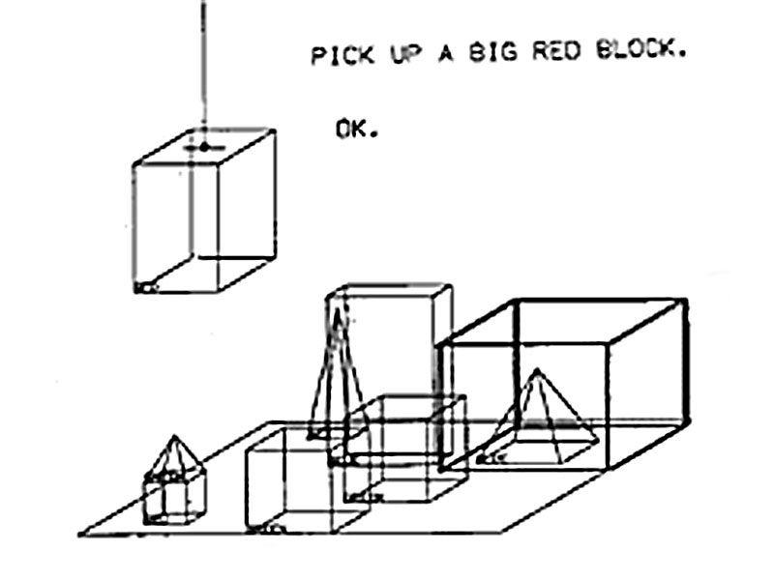
Blocks world
One of the earliest AI planning domains (1960s)
Terry Winograd’s SHRDLU system (1968) combined a natural language dialog system with a blocks world planner.

Slide 17
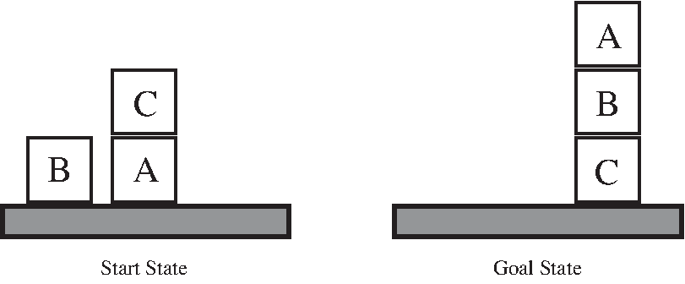
Blocks world basics
The robot “hand” can only pick up one block at a time.
A block is only graspable if there is no block on top of it.
A block has room for at most one block on top of it.
The table has unlimited capacity.
Predicates:
  On(block₁, block₂)
  On(block, table)
  ClearTop(block)

Slide 18
Blocks world actions: Move
MOVE(block, destination)
Preconditions:
ClearTop(block)
ClearTop(destination)
On(block, place)
Add list:
On(block, destination)
Delete list:
On(block, place)
ClearTop(destination)

Slide 19
Blocks world actions: MoveToTable
MOVETOTABLE(block)
Preconditions:
ClearTop(block)
On(block, place)
Add list:
On(block, table)
Delete list:
On(block, place)

Slide 20
The Sussman anomaly
Start:
On(C,A)
On(B,table)
On(A,table)
ClearTop(B)
ClearTop(C)
Goal:
On(A,B)
On(B,C)
On(C,table)
On(B,C) can be satisfied in one move.
But is that a good idea?

Slide 21
Sussman: ordering of subgoals matters!
B
C
FAIL!
A
B to C
A
B
A to B
B
C
A
C
C
B
A
B to C
C to table
B
A
C
A
FAIL!
A to B
B
C

Slide 22
PDDL: Planning Domain Definition Language
A notational convention for specifying planning problems. Looks like Lisp.
Makes it easy to share problems among researchers, and to hold planning competitions.
Elements of a PDDL specification:
A set of objects
A set of predicates
Initial state
Goal specification
Action specifications: name, preconditions, add list, delete list

Slide 23
The spare tire problem
A car has a flat tire. You need to swap it with the spare.
The boot (trunk) contains:
  A spare tire, not inflated
  A jack
  A lug wrench
  A pump
The boot is initially closed, but can be opened or closed at will.
Items can be moved into or out of the boot only when it’s open.
Tires are attached to axles by nuts.
Nuts can be removed using the lug wrench while the car is on the ground.
Tires can be removed or put on the axle only when the car is jacked up.
All tools and the flat tire should be placed back in the boot, and the boot should be closed, before driving off.

Slide 24
Spare tire world action: FetchTool
FETCHTOOL(t)
Preconditions:
Tool(t)
In(t, boot)
Open(boot)
Add list:
Have(t)
Delete list:
In(t, boot)

Slide 25
Why is spare tire challenging?
Lots of possible actions at each step
Plenty of opportunity for cycles: fetch a tool, put it away, fetch it again…
Actions that block other actions:
  Putting away a tool blocks its use
  Closing the boot blocks further fetch or put away actions
  Jacking up the car blocks use of the lug wrench

Slide 26
Complexity of classical planning
PlanSAT: is there a plan that satisfies the goal?
Bounded PlanSAT: is there a plan of length at most k that satisfies the goal?
Good news: classical planning is decidable.
Why? Because the number of states is finite.
But both PlanSAT and BoundedPlanSat are in complexity class PSPACE, which is worse than NP-hard.
We need good heuristics to make planning efficient.

Slide 27
Planning heuristics to speed up search
We can use heuristic search (e.g., A* search) through the state space if we have a suitable heuristic for estimating cost.
Relaxing the problem is a good source of heuristics.
Ignore preconditions heuristic: if any action can be taken at any time, how many actions are needed to reach the goal? Our cost measure is just the number of unsatisfied goal predicates.
Ignore delete lists heuristic: if predicates never become false, every action makes progress toward the goal, or at least doesn’t make things worse.

Slide 28
Planning heuristics (continued)
State abstraction: if we have many interchangeable objects, replace them with individual objects to reduce the size of the state space.
Subgoal independence: assume that the cost of achieving a conjunction of subgoals is equal to the sum of the costs of achieving each subgoal independently.
  Optimistic (admissible) when plans’ actions interfere.
  Pessimistic (inadmissible) when plans have common actions that could be collapsed.
  Using max instead of sum guarantees admissibility (but is less accurate).

Slide 29
Planning Graphs
A neat data structure for estimating distance to the goal state.
A planning graph:
Takes only polynomial space
  A complete state space tree would take exponential space.
Provides optimistic estimates (admissible heuristic)
Can also be used for plan generation (GRAPHPLAN)
Requires a propositionalized representation: no variables

Slide 30
Simple planning problem
Initial state: Have(cake)
Goal: Have(cake), Eaten(cake)
Action Eat(cake):
Preconditions: Have(cake)
Effects: ¬Have(cake), Eaten(cake)
Action Bake(cake):
Preconditions: ¬Have(cake)
Effects: Have(cake)
Solution:
Eat(cake)
Bake(cake)

Slide 31
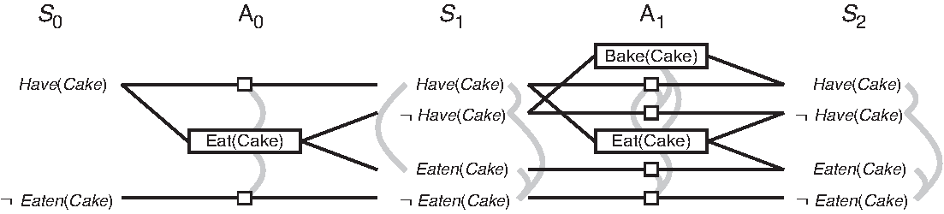
Planning graph representation of cake problem
Mutual exclusion: interference and inconsistent effects
Mutual exclusion: negation
Mutual exclusion: inconsistent support
Mutual exclusion: interference and inconsistent effects
Mutual exclusion: competing needs
Persistence action (no-op)

Slide 32
Mutual exclusion links between actions
Inconsistent effects: one action negates an effect of another.
  Eat(cake) deletes Have(cake) so is inconsistent with persistence of Have(cake)
  Eat(cake) adds Eaten(cake) so is inconsistent with persistence of ¬Eaten(Cake)
Interference: one of the effects of one action is the negation of the precondition for another.
  Eat(cake) negates the preconditions of the persistence actions for Have(cake) and ¬Eaten(Cake
Competing needs: one of the preconditions of one action is mutually exclusive with a precondition of the other.
  Bake(cake) requires ¬Have(cake) while Eat(cake) requires Have(cake)

Slide 33
Mutual exclusion links between propositions
Negation: one proposition is the negation of the other.
  Have(cake) and ¬Have(cake) are mutually exclusive.
Inconsistent support: all the actions for establishing one proposition are mutually exclusive with the actions of establishing the other proposition.
  Have(cake) and Eaten(cake) are mutex in S₁ because all their establishing actions are mutex
  Have(cake) and Eaten(cake) are not mutex in S₂

Slide 34
Using the planning graph
Build out the graph by applying all possible actions until it “levels off” meaning that proposition level S_{i} = S_{i+1}.
If any term g_{i} of the goal is not present in S_{n}, the problem has no solution.
Estimate the cost of achieving any goal term g_{i} by the level at which it first appears in the planning graph.
Estimate the cost of the goal as the sum of costs of the g_{i}, or as the level at which all goal terms first appear together.

Slide 35
The GRAPHPLAN Algorithm
function GRAPHPLAN(problem) returns solution or failure
graph ← INITIAL-PLANNING-GRAPH(problem)
goals ← CONJUNCTS(problem.GOAL)
nogoods ← empty hash able
for t = 0 to ∞ do
if goals all non-mutex in S_{t} of graph then
solution ← EXTRACT-SOLUTION(graph, goals, NUMLEVELS(graph), nogoods)
if solution ≠ failure then return solution
if graph and nogoods have both leveled off then return failure
graph ← EXPAND-GRAPH(graph, problem)

Slide 36
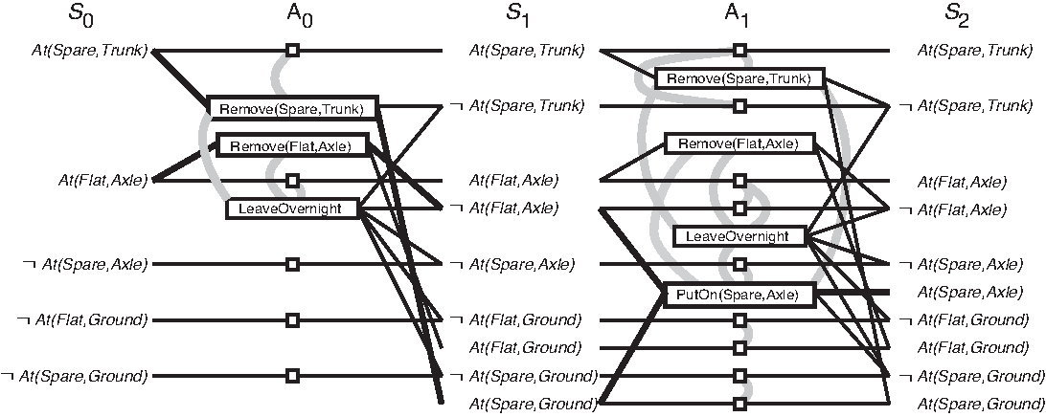
Simplified spare tire; some mutex links not shown

Slide 37
GRAPHPLAN notes
Why keep expanding the graph after it has leveled off?
  Because although all goal terms are present at layer S_{i}, it may not be possible to achieve all of them simultaneously without a longer plan.
How does EXTRACT-SOLUTION work?
  Search backward from the last layer, finding a subset of actions that satisfies the goals, and making their preconditions into new goals.
  If we fail to establish a goal at level i, record this in the nogoods table so we don’t try it again.
When does the algorithm terminate?
  If a solution is found.
  If both the graph and the nogoods table have leveled off: report failure.

Slide 38
Summary
Planning is problem solving using representations of states and actions.
Actions are defined by preconditions and add and delete lists.
There are many ways to formulate planning problems:
  Constraint satisfaction
  First-order logical deduction
  Boolean satisfiability
  State space search
Planning is an important application area for AI, with many practical applications.

